Slide 1
Proposal for a revision of the CityGML LOD concept
CityGML WP 03
Claus Nagel

Slide 2
Part 1: Our proposal
General idea
UML realization (first draft…)
Examples

Slide 3
General idea
Each city object has a spatial representation in every LOD
As in CityGML 2.0, the spatial representation is refined in higher LODs
Usage restrictions on feature types over different LODs are resolved
Each feature type can be modelled in every LOD → LOD 4 becomes needless
Note: CityGML 2.0 restricts the usage of some feature types in lower LODs and thus restricts the semantic richness in lower LODs → our proposal allows for semantically richer models!
This is the only (but important) conceptual change that we propose to CityGML 2.0

Slide 4
Realization in UML (first draft…)
Each city object has a spatial representation in every LOD
Note: LOD is modelled explicitly as association qualifier (alternative ways are possible as well)
The geometry types per LOD are refined for every sub-feature (see next slides)
Simple and consistent
And: As close as possible to CityGML 2.0

Slide 5
AbstractBuilding feature type (excerpt)
UML representation is almost identical with current definition in CityGML 2.0
Except for missing LOD 4 property and the association qualifier
Note: The meaning of the LOD representation is the same

Slide 6
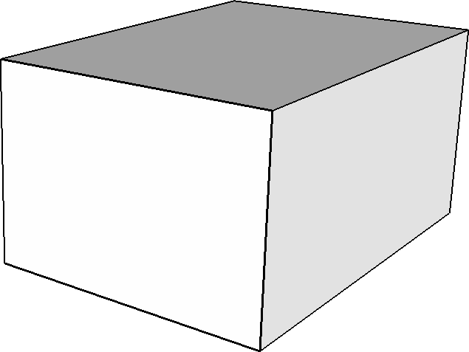
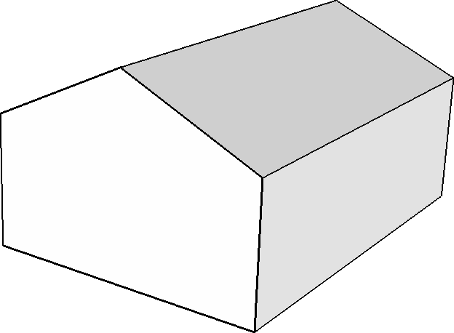
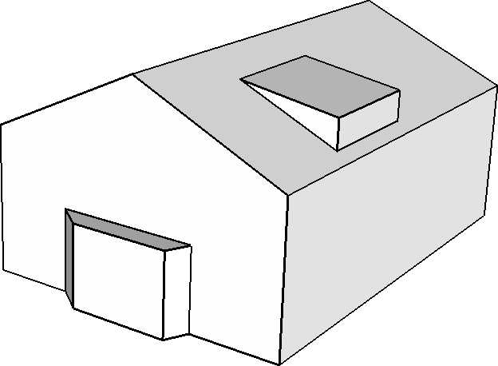
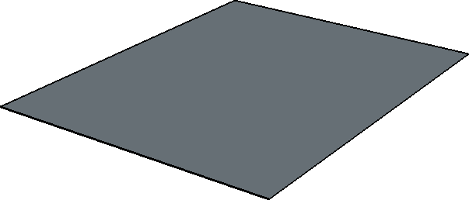
Building feature type over different LODs
LOD 0
LOD 1
LOD 2
LOD 3
The spatial representation is refined over the LODs (like in CityGML 2.0)
Note: This example only shows the geometry of the Building feature type
Thus, the exterior building shell (as in CityGML 2.0)

Slide 7
AbstractBoundarySurface feature type (excerpt)
New: Explicit spatial representation in LOD 0 and LOD 1
Note: The LOD 0 of the RoofSurface, FloorSurface and CeilingSurface sub-features might additionally allow a GM_MultiSurface representation (debatable)

Slide 8

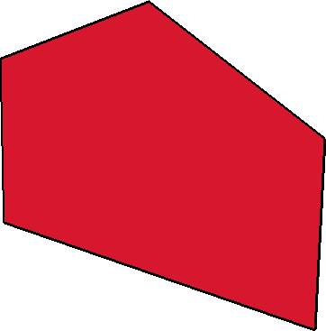
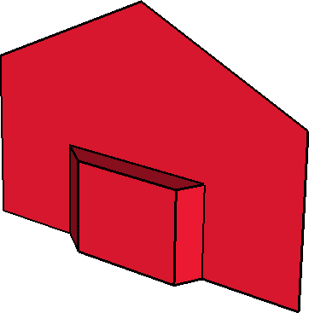

WallSurface feature type over different LODs
LOD 0
LOD 1
LOD 2
LOD 3
New: Boundary surfaces can be represented in each LOD (as every feature type)
Is the name WallSurface still OK if the LOD 0 representation is a curve?
YES. The feature represents the “surface of a wall” in real word. The curve geometry in LOD 0 is just a spatial abstraction of that wall surface – but this does not affect the meaning of the feature.

Slide 9
SolitaryVegetationObject feature type (excerpt)
New: Trees can now be spatially represented as points in LOD 0
Note: CityGML 2.0 defines an LOD 4 geometry for solitary vegetation objects without explaining it (what is the interior of a tree?) → our LOD proposal resolves this ambiguity

Slide 10
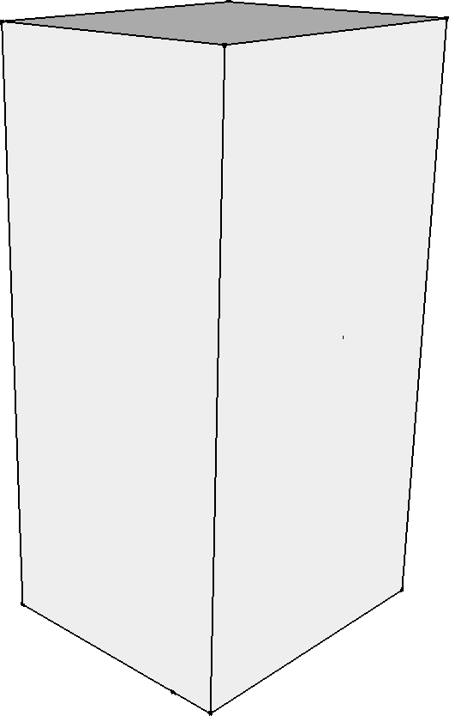
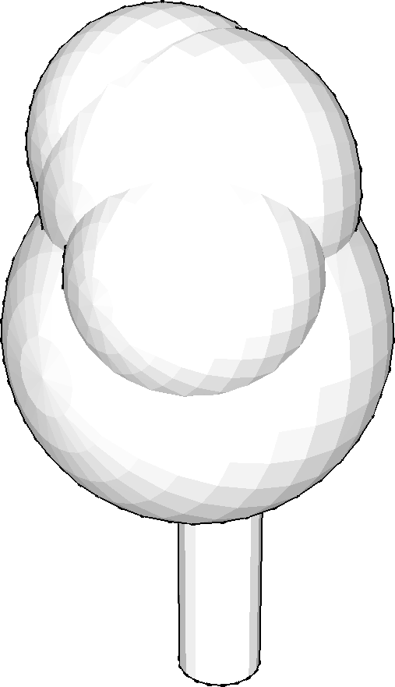

SolitaryVegetationObject feature type over different LODs
LOD 0
LOD 1
LOD 2
LOD 3
Consistent: The same LOD concept applies to all feature types in all thematic modules
Note: The general idea should be clear now – the UML diagrams for other feature types are not shown in this presentation

Slide 11
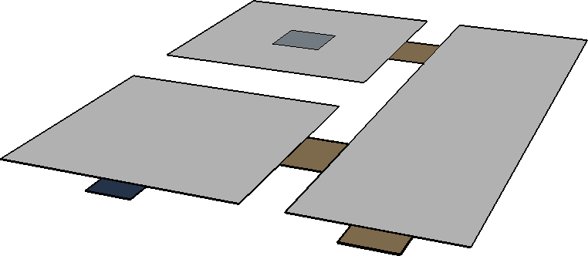
Example: Floor plans
IntBuildingInstallation (column) in LOD 0
Room in LOD 0
InteriorWallSurface (curve) in LOD 0
Door in LOD 0
Window in LOD 0
New: We can model floor plans in CityGML using LOD 0 features
New: We can use all feature types in LOD 0 → the floor plan is semantically rich (we can query it for wall surfaces, doors, columns, etc.)
Required by indoor navigation, indoor FM, etc. (see current CRs!)

Slide 12
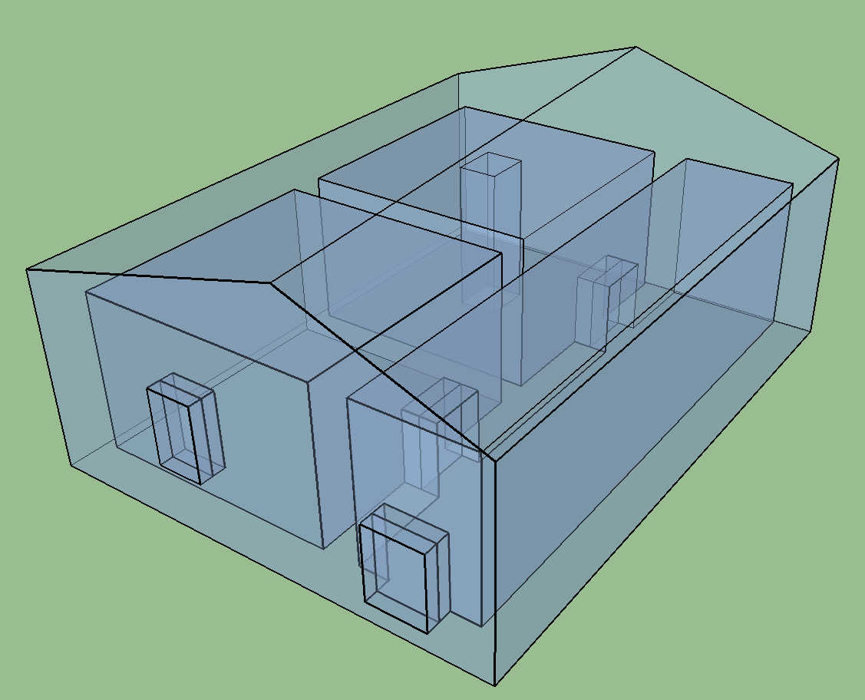
Example: LOD 2 building model
RoofSurface in LOD 2
IntBuildingInstallation (column) in LOD 2
Room in LOD 2
InteriorWallSurface in LOD 2
CeilingSurface and FloorSurface in LOD 2
Window in LOD 2
Door in LOD 2
WallSurface and GroundSurface in LOD 2
Building (outer shell) in LOD 2
New: Exterior and interior feature types can be modelled in every LOD
Note: Interior feature types are optional – we could still have just the LOD 2 outer shell but we are not restricted to that anymore!

Slide 13
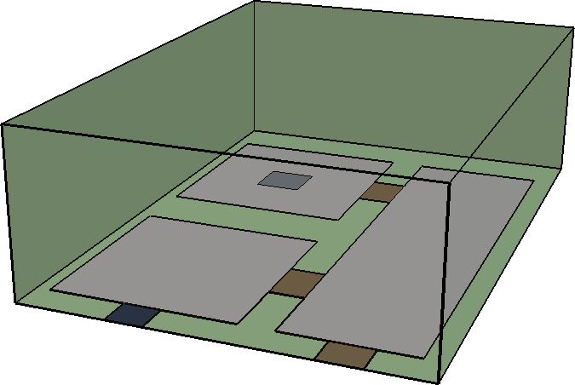
Example: Building model with features in LOD 0 and LOD 1
IntBuildingInstallation (column) in LOD 0
Building (outer shell) in LOD 1
Room in LOD 0
InteriorWallSurface (curve) in LOD 0
Door in LOD 0
Window in LOD 0
Applications may freely combine feature types from different LODs for their purposes
Note: Whether this makes sense must be answered by the application
If this does not make sense for your application, then don’t do it!

Slide 14
Profiles
How can I restrict boundary surfaces to be available only in LOD 2 or higher?
Answer: Define a profile
Definition in CityGML standard:
“Old LOD 2” profile:
{2 <= lod <= 3}
Profiling is the ISO way to restrict CityGML to your needs
Using our proposal, all “old” LODs from CityGML 2.0 can be realized as profiles
Note: Clear and simple link to CityGML 2.0

Slide 15
Summary
Idea: Resolve usage restrictions on feature types over different LODs
Each feature type can be spatially represented in every LOD
Simple
To explain, to understand, to implement
No “exterior vs. interior” or “geometric vs. semantic” LOD
Clear and simple link to LOD concept in CityGML 2.0 Note: I completely disagree with the minutes of the last meeting that the SIG3D labelling is closer to CityGML 2.0
Consistent
The same LOD concept applies to all feature types in all thematic modules
No complex usage restriction matrixes that differ for different feature types
No break with existing terminology
Simple migration path for existing CityGML 2.0 data
Covers all current use cases plus current requests from Change Requests

Slide 16
Part 2: Comparison with SIG3D proposal
Mapping of SIG3D examples
Some issues in SIG3D proposal

Slide 17
Relation to SIG3D proposal
Hypothesis: The SIG3D approach is a limited subset of our proposal
Especially due to the predefined usage restrictions on feature types in some LODs
All examples presented for the SIG3D approach can be easily expressed in our proposal
This is demonstrated in the following for the examples provided in the slide set “SIG3D proposal for a revised CityGML LoD concept” from Joachim Benner; available from the GitHub repository of the WP03: https://github.com/opengeospatial/CityGML-3.0/blob/master/WP%2003%20Resources/Meetings/2nd/CityGML_LoDConcept_SIG3D.pdf

Slide 18
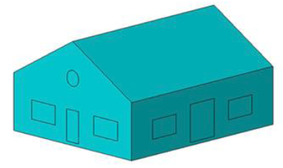
Building model in LOD 2
SIG3D
Example 1: LOD 2 exterior shell without interior structure
Note: Doors and windows are just modelled geometrically
SIG3D label: “LoD2”

Slide 19
Building model in LOD 2
Our proposal
Example 1: LOD 2 exterior shell without interior structure
Note: Doors and windows are just modelled geometrically
Building (outer shell) in LOD 2
This is simply a Building feature in LOD 2

Slide 20
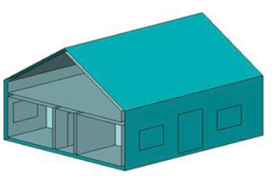
Building model in LOD 2
SIG3D
Example 2: LOD 2 exterior shell with LOD 2 rooms
Note: Doors and windows are just modelled geometrically
SIG3D label: “LoD2.2”

Slide 21
Building model in LOD 2
Our proposal
Example 2: LOD 2 exterior shell with LOD 2 rooms
Note: Doors and windows are just modelled geometrically
Building (outer shell) in LOD 2
Room in LOD 2
This is simply a Building feature with Room features in LOD 2

Slide 22
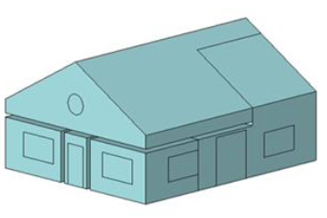
Building model in LOD 2
SIG3D
Example 3: LOD 2 rooms without exterior shell
Note: Doors and windows are just modelled geometrically
SIG3D label: “LoD.2”

Slide 23
Building model in LOD 2
Our proposal
Example 3: LOD 2 rooms without exterior shell
Note: Doors and windows are just modelled geometrically
Room in LOD 2
These are simply Room features in LOD 2

Slide 24
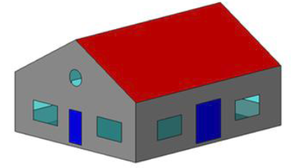
Building model in LOD 2
SIG3D
Example 4: Semantically classified exterior shell without interior structure
SIG3D label: “S3”
Note: Geometry remains “Lod2” in SIG3D terminology

Slide 25
Building model in LOD 2
Our proposal
Example 4: Semantically classified exterior shell without interior structure
RoofSurface in LOD 2
Building (outer shell) in LOD 2 (optional)
WallSurface in LOD 2
Door and Window in LOD 2
This is simply a Building feature with thematic BoundarySurface, Door and Window features in LOD 2

Slide 26
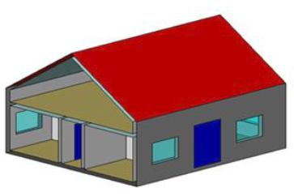
Building model in LOD 2
SIG3D
Example 5: Semantically classified exterior shell with interior structure
SIG3D label: “S3.3”
Note: Geometry remains “Lod2” in SIG3D terminology

Slide 27
Building model in LOD 2
Our proposal
Example 5: Semantically classified exterior shell with interior structure
RoofSurface in LOD 2
Building (outer shell) in LOD 2
InteriorWallSurface in LOD 2
WallSurface in LOD 2
FloorSurface and CeilingSurface in LOD 2
Door and Window in LOD 2
Room in LOD 2
This is simply a Building feature with thematic BoundarySurface (exterior plus interior), Room, Door and Window features in LOD 2

Slide 28
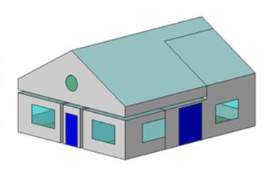
Building model in LOD 2
SIG3D
Example 6: Semantically classified interior structure without exterior shell
SIG3D label: “S.3”
Note: Geometry remains “Lod2” in SIG3D terminology

Slide 29
Building model in LOD 2
Our proposal
Example 6: Semantically classified interior structure without exterior shell
CeilingSurface in LOD 2
Room in LOD 2
InteriorWallSurface in LOD 2
WallSurface in LOD 2
FloorSurface in LOD 2
Door and Window in LOD 2
These are simply Room features with thematic BoundarySurface, Door and Window features in LOD 2

Slide 30
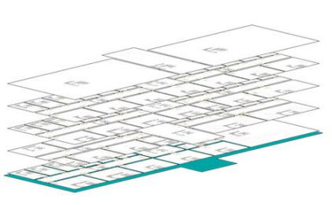
Building floor plan in LOD 0
SIG3D
Example 7: Building floor plan in LOD 0
SIG3D label: “LoD0.0(S0.0)”
Note: Only geometric representation – no additional semantics about doors, walls, etc.
However, this additional information is required, for instance, in indoor navigation

Slide 31
Building floor plan in LOD 0
Our proposal
Example 7: Building floor plan in LOD 0
Room in LOD 0
Doors and Windows in LOD 0
InteriorWallSurface (curve) in LOD 0
WallSurface (curve) in LOD 0
Building (outer shell) in LOD 0
This is simply a Building feature with thematic BoundarySurface (exterior plus interior), Room, Door and Window features in LOD 0
Consistent with LOD 2 example
In contrast to the SIG3D proposal, the floor plan is semantically rich

Slide 32
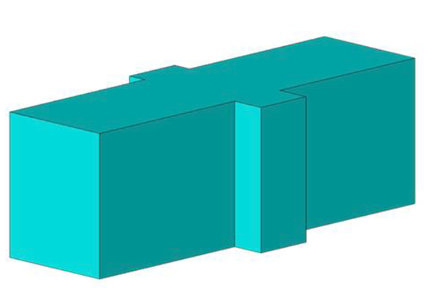
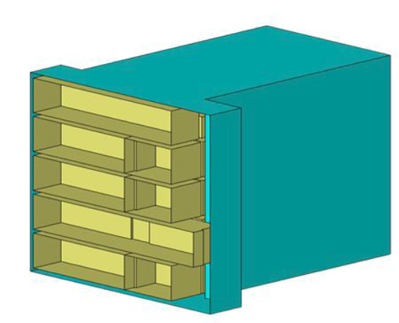
Building model in LOD 1
SIG3D
Example 8: Exterior shell in LOD 1 with rooms
SIG3D label: “LoD1.1(S0.0)”

Slide 33
Building model in LOD 1
Our proposal
Example 8: Exterior shell in LOD 1 with rooms
Building (outer shell) in LOD 1
Room in LOD 1
This is simply a Building feature with Room features in LOD 1
Consistent with LOD 2 example
In contrast to the SIG3D proposal – and consistent with the previous examples – we could also model exterior and interior thematic BoundarySurfaces, Windows, Doors, etc.

Slide 34
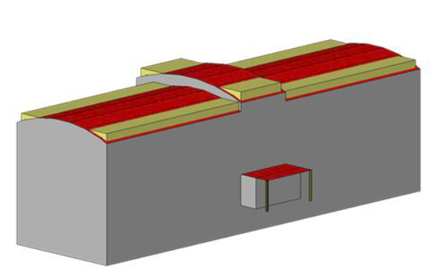
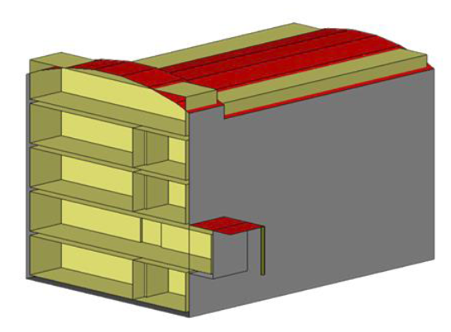
Building model in mixed LODs
SIG3D
Example 9: Semantically rich exterior shell in LOD 2 and rooms in LOD 1
SIG3D label: “LoD2.1(S2.0)”
Question: If you would be asked to sketch an “Lod2.1(S2.0)” building without knowing the above figure, would you be able to come up with something like this?

Slide 35
Building model in mixed LODs
Our proposal
Example 9: Semantically rich exterior shell in LOD 2 and rooms in LOD 1
RoofSurface in LOD 2
Building (outer shell) in LOD 2
WallSurface in LOD 2
Room in LOD 1
This is simply a Building feature with thematic BoundarySurface features in LOD 2 and Room features in LOD 1

Slide 36
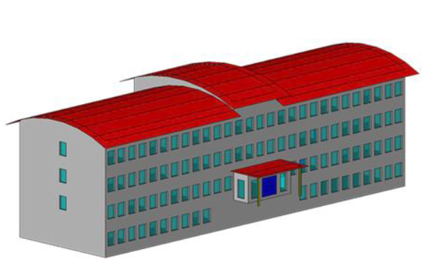
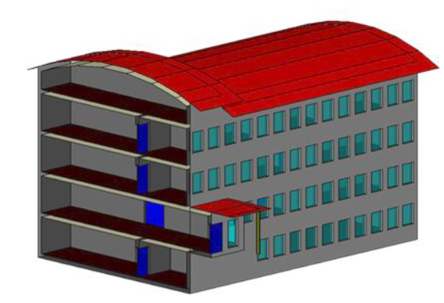
Building model in LOD 3
SIG3D
Example 10: Semantically rich exterior shell and interior structures in LOD 3
SIG3D label: “LoD3.3(S3.3)”

Slide 37
Building model in LOD 3
Our proposal
Example 10: Semantically rich exterior shell and interior structures in LOD 3
RoofSurface in LOD 3
Rooms in LOD 3
Building (outer shell) in LOD 3
Doors and Windows in LOD 3
WallSurface in LOD 3
CeilingSurface and FloorSurface in LOD 3
InteriorWallSurface in LOD 3
This is simply a Building feature with thematic BoundarySurface (exterior plus interior), Room, Door and Window features in LOD 3
Consistent with LOD 2 example

Slide 38
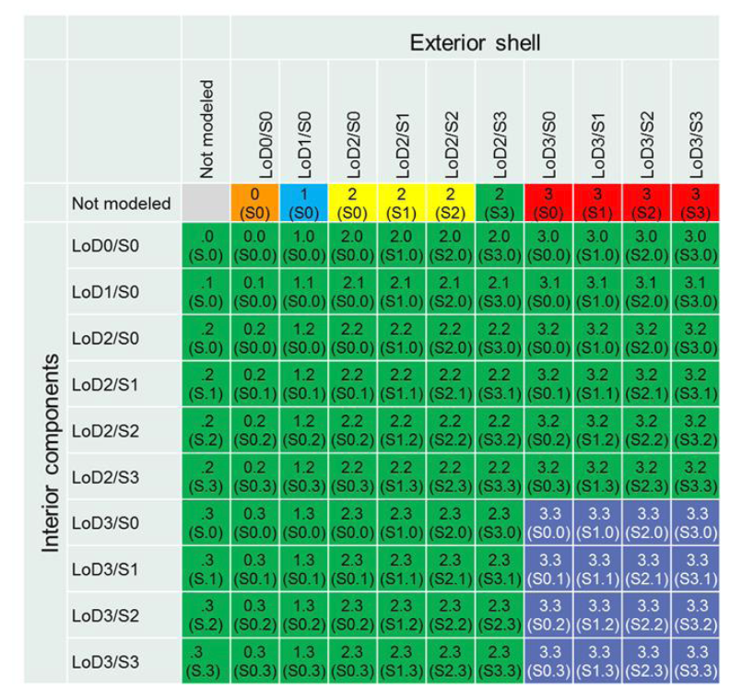
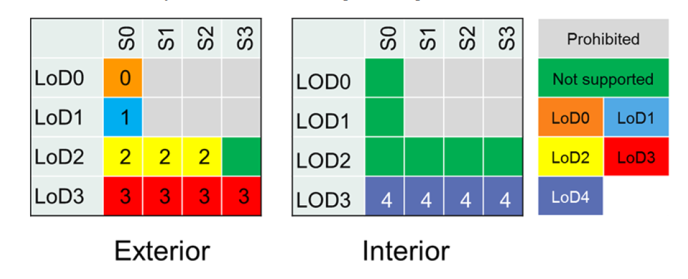
SIG3D LOD matrixes and usage restrictions
Complex to explain, to understand and to implement
Not required in our proposal
If you want to restrict the model, simply go ahead and define a profile

Slide 39
Issues in SIG3D proposal (I)
LOD is defined at different levels
When talking about a “building”, the SIG3D proposal always refers to a composed feature consisting of nested features such as boundary surfaces, windows, doors, rooms, etc. – but the SIG3D proposal never refers to the Building feature type itself
The LOD definition for a composed feature such as a “building” then involves geometric and semantic aspects (e.g. “Lod2.2(S2.2)”) as well as usage restriction matrixes that mainly affect the nested feature types
Other feature types such as AbstractBoundarySurface, Room, BuildingInstallation, etc. are considered to be secondary features – their LOD is only defined geometrically (no semantic aspects, no usage restriction matrixes)
However, also boundary surfaces, rooms, building installations can have nested features and hence are composed features!
For this reason, the SIG3D proposal is inconsistent
This also makes the proposal complex and hard to understand
In our proposal, LOD is consistently defined on the level of feature types

Slide 40
Issues in SIG3D proposal (II)
Semantic LOD label
A “semantic LOD label” is used to denote the semantic richness of a composed feature
This label only follows from the nested feature types contained in a composed feature
BUT: We get the same information by simply evaluating the nested feature types at run-time
The semantic LOD label is used as static attribute
The label is only correct if the feature is not changed after having set the label
However, features are subject to change in practice: doors, windows, installations, boundary surfaces, etc. may be deleted from or added to a building over time – the semantic richness is dynamic
The SIG3D does not provide any specification on who, how or when to update the label – how to implement software against this proposal?
BUT: If you simply evaluate the feature after the changes, you will always have an up-to-date understanding of its semantic richness
That’s why we do not use a semantic label → simply evaluate the feature types

Slide 41
Issues in SIG3D proposal (III)
SIG3D: “A main benefit of the semantic LOD label is that it implies model completeness”
Put differently: If we have a S3 building, then all doors, windows, installations, etc. that the building has in real world are guaranteed to be represented in the model
Which data provider would guarantee such a model completeness?
I mean this seriously: Let’s have a survey to understand who would make such a guarantee!
Some questions that come to my mind
Assume a building in a database is updated by adding/deleting some Room, Door, Window, or WallSurface features through a WFS interface
How do you (or the WFS) know whether or not the building is complete before or after the changes?
If you cannot tell, you probably would not update the label... This may lead to inconsistent states
Assume that we only want to request the exterior shell from an “Lod2(S3)” building through a WFS
May (must) the WFS change the label to LoD2(S0) in the response dataset?
None of these questions is addressed by the SIG3D proposal – how to implement it?
That’s why we do not propose a completeness assumption

Slide 42
Issues in SIG3D proposal (IV)
The SIG3D proposal has currently only been exemplified for buildings
How does the LOD definition work for the other thematic modules?
Do we get additional and different usage restriction matrixes (besides those for “building”) for composed features from the other thematic modules?
If so, then this clearly adds further complexity to the proposal
Our proposed LOD concept applies to all feature types in all thematic modules in the same way

Slide 43
Part 3: Bridging the gap…
Conceptual agreement
Some thoughts on quality measures

Slide 44
Conceptual agreement between both proposals
Many conceptual similarities
LOD 4 is skipped by both proposals
Features that are only available in higher LODs in CityGML 2.0 can already be modelled in lower LODs
Applications may freely combine features from different LODs
Main differences (from my point of view)
SIG3D usage restrictions on feature types
Semantic but static LOD label used by SIG3D

Slide 45
Usage restrictions on feature types
If we agree that indoor navigation requires semantically rich floor plans, and if we agree that indoor navigation is an application domain that we want to support with CityGML (see Change Requests),
Then the LOD 0 usage restrictions on feature types as defined by the SIG 3D proposal must be resolved and, consequently, the usage restrictions in higher LODs must be revisited as well.
Central question: Given that there might be more applications like indoor navigation (including future ones we do not know about today), shouldn’t the CityGML standard be as flexible as possible to support them?

Slide 46
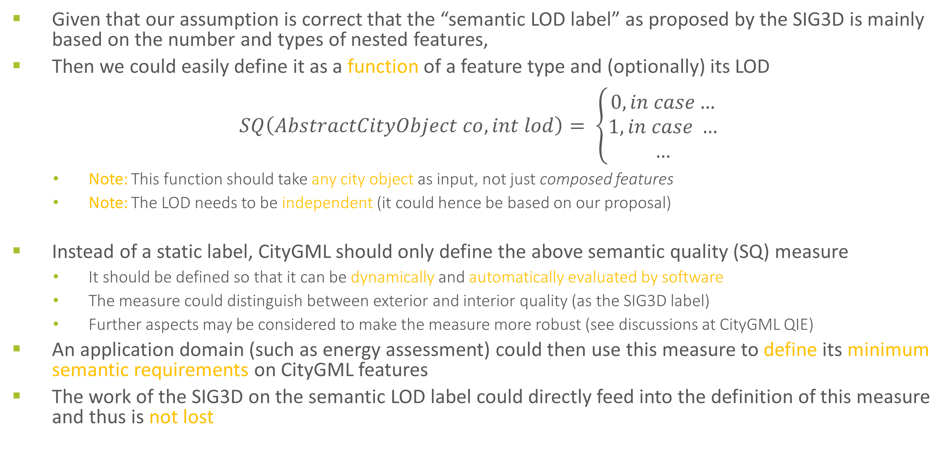
Semantic quality measure (only first thoughts…)
Given that our assumption is correct that the “semantic LOD label” as proposed by the SIG3D is mainly based on the number and types of nested features,
Then we could easily define it as a function of a feature type and (optionally) its LOD
$$SQ\left(AbstractCityObject co, int lod\right)= \left\{\begin{aligned}0, in case… \\ 1, in case … \\ …\end{aligned}\right.$$
Note: This function should take any city object as input, not just composed features
Note: The LOD needs to be independent (it could hence be based on our proposal)
Instead of a static label, CityGML should only define the above semantic quality (SQ) measure
It should be defined so that it can be dynamically and automatically evaluated by software
The measure could distinguish between exterior and interior quality (as the SIG3D label)
Further aspects may be considered to make the measure more robust (see discussions at CityGML QIE)
An application domain (such as energy assessment) could then use this measure to define its minimum semantic requirements on CityGML features
The work of the SIG3D on the semantic LOD label could directly feed into the definition of this measure and thus is not lost

Slide 47
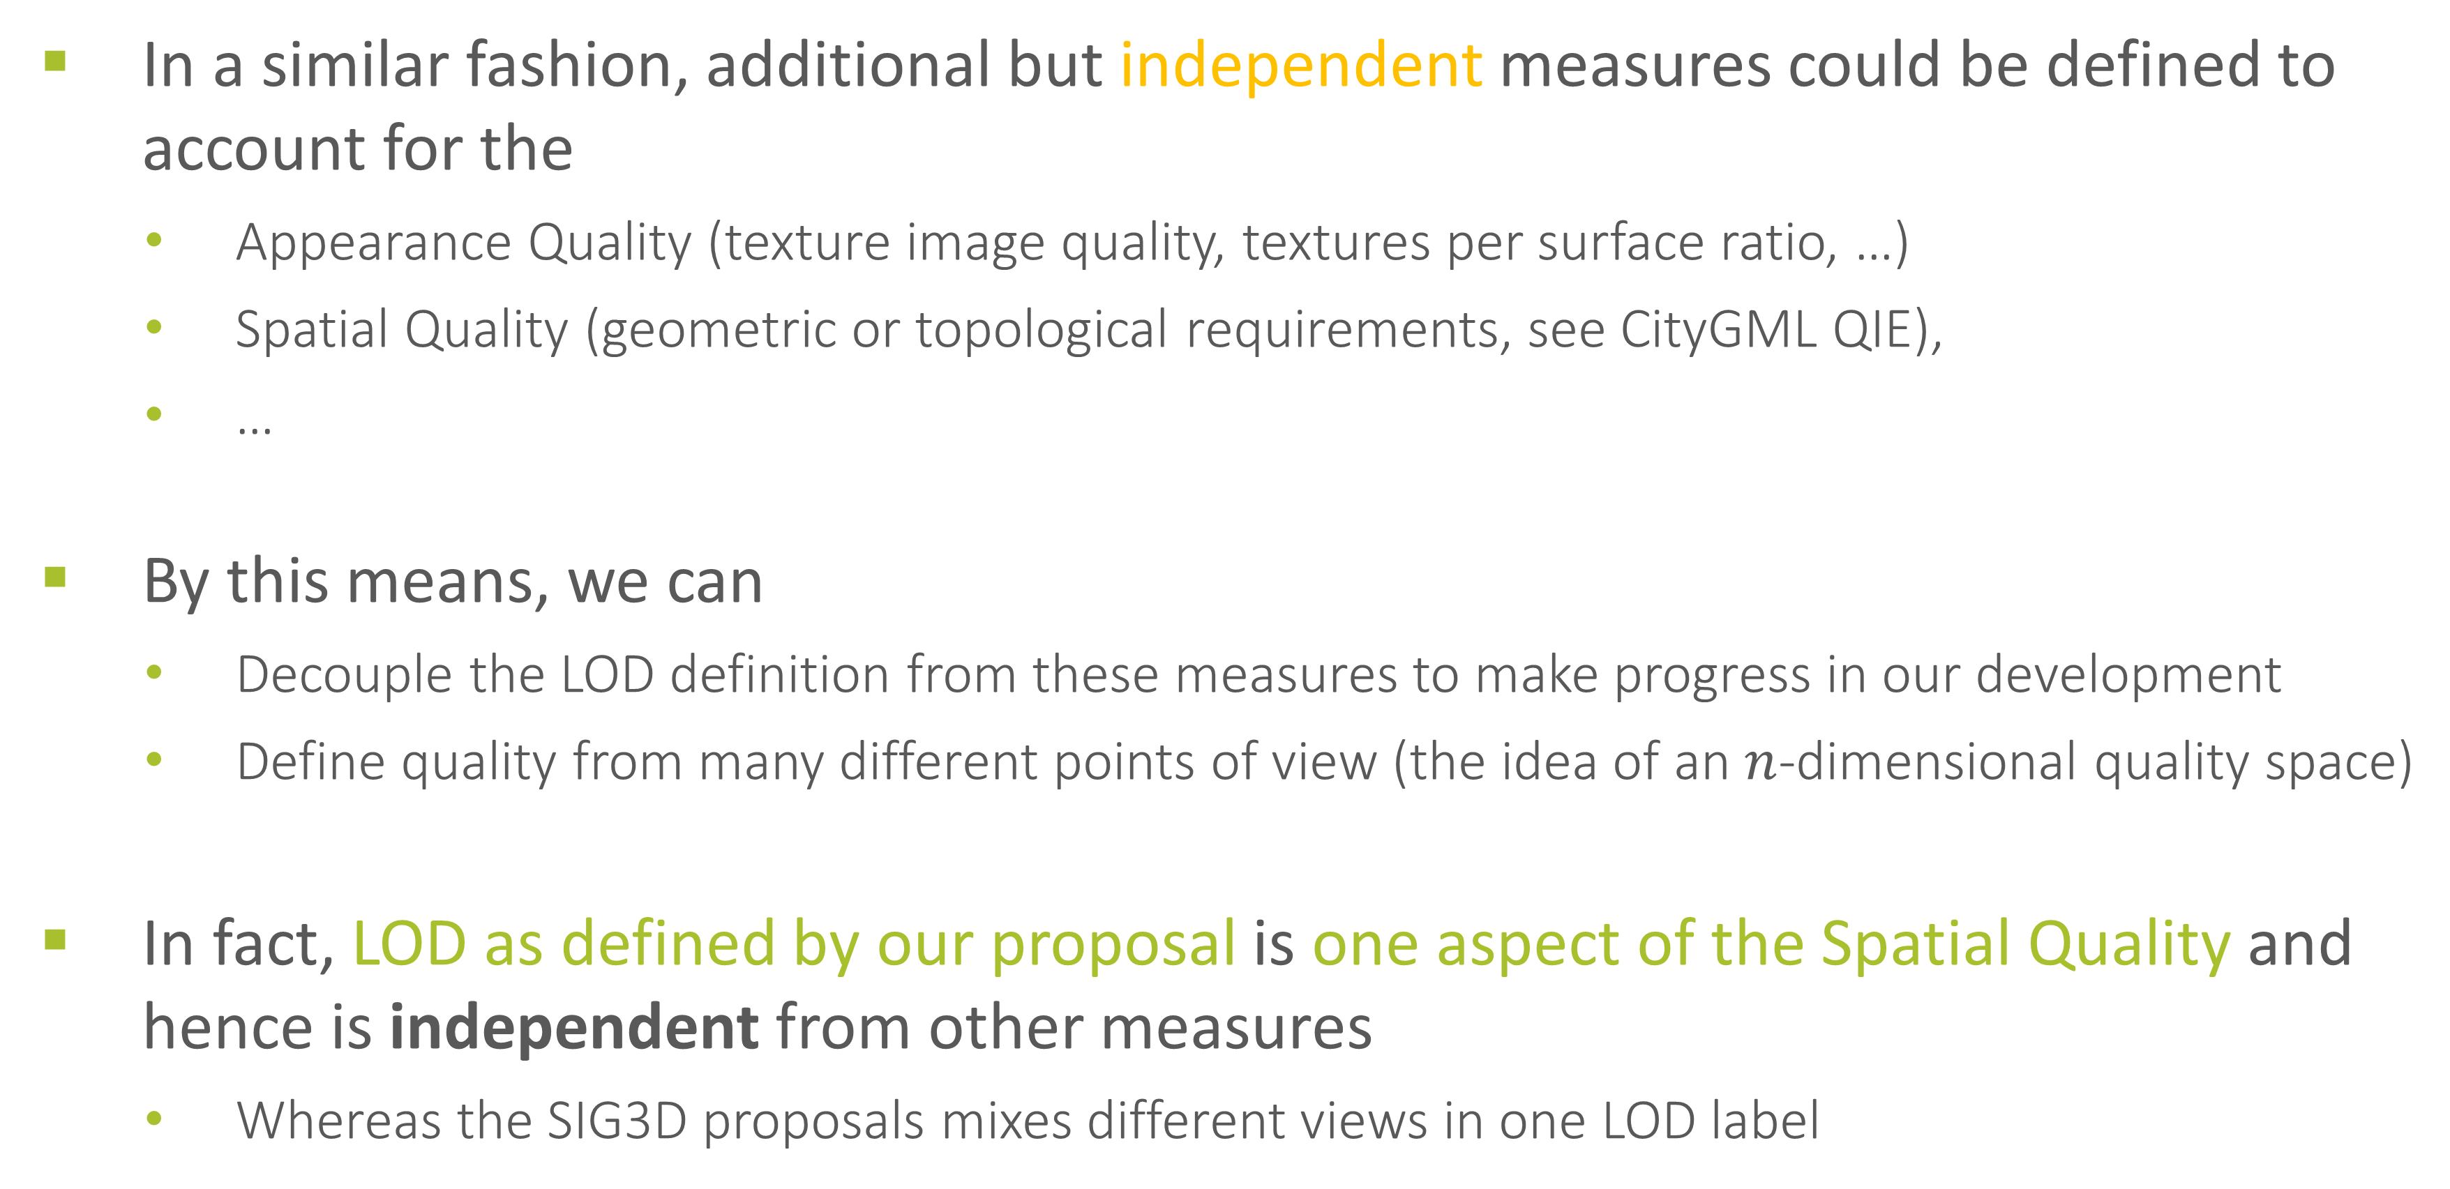
Additional measures (only first thoughts…)
In a similar fashion, additional but independent measures could be defined to account for the
Appearance Quality (texture image quality, textures per surface ratio, …)
Spatial Quality (geometric or topological requirements, see CityGML QIE),
…
By this means, we can
Decouple the LOD definition from these measures to make progress in our development
Define quality from many different points of view (the idea of an $n$-dimensional quality space)
In fact, LOD as defined by our proposal is one aspect of the Spatial Quality and hence is independent from other measures
Whereas the SIG3D proposals mixes different views in one LOD label

